Slide 1
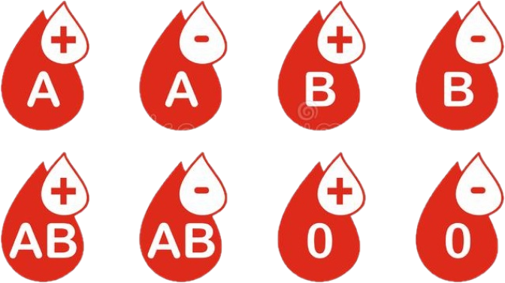
Blood Bank Management System

Slide 2

Kamla Nehru Institute of Technology, Sultanpur (U.P.)
Submitted By:
Ravikant
Pankaj Kumar
Nikshep Paliwal
Priyanshu Subberwal

Slide 3
Introduction
Blood Bank Management System is a web based application.
The purpose of this project was to develop a blood management information system to assist in the management information system.
This project includes some modules i.e. Admin module, Donor module, Blood bank login, DashBoard, Home page.
The Current System of Manual Blood Bank is Time consuming that’s why we are developing Online Blood Bank Management System.

Slide 4
Objective
Objective of this project is to maintain the Blood Bank System.
They have to maintain donor and receiver details.
This software helps to easy management of records such as management of blood donors, availability of blood etc.
Component preparation details, Blood Issue details, Blood request details.

Slide 5
Scope
This system has a wide scope, as it is not intended to a particular organization. This project is going to develop generic software, which can be applied by any business organization. Moreover, it provides facility to its users. Also the software is going to provide a huge amount of Summary data.

Slide 6
Modules
Manage Donor Information
Manage availability of blood.
Manage Buyer information.
Manage Activity.
Instant search of required blood group and issue to patient.

Slide 7
Software & Language Used
Frontend
HTML5
CSS3
Java Script
Backend
Express JS
Node JS
Mongo DB
Software
Mongo DB
Visual Studio

Slide 8
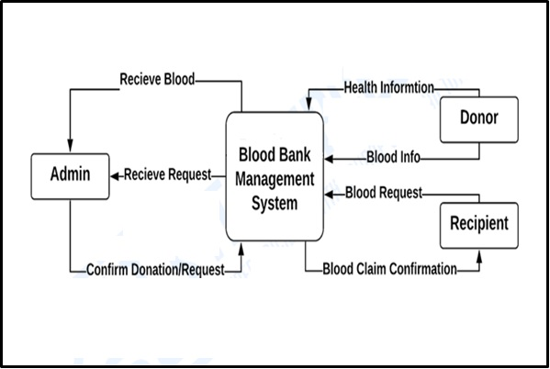
D F D (Data Flow Diagram)
Zero Level DFD – Blood Bank Management System

Slide 9
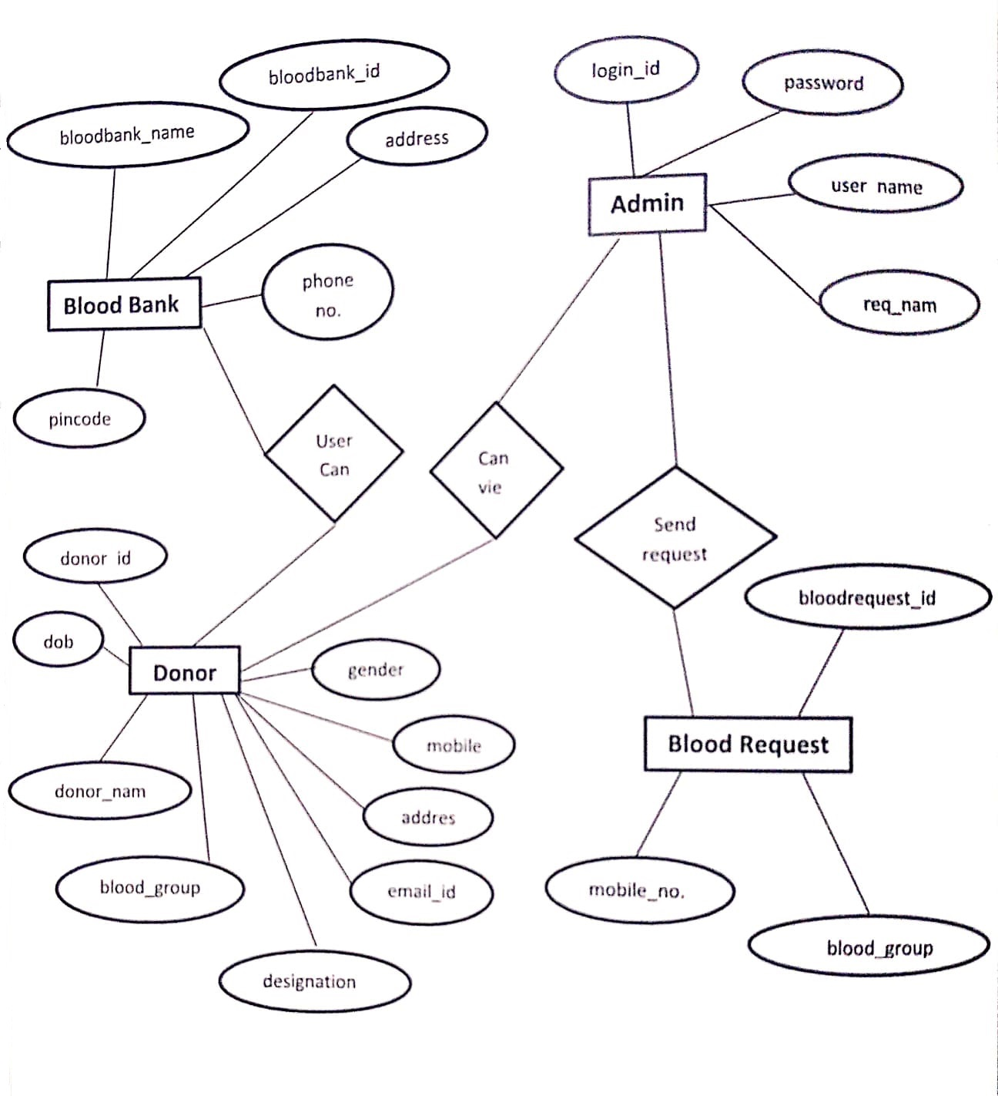
ER Diagram

Slide 10
Use Case Diagram
Use case diagram consists of use cases and shows the interaction between them. The key points are:
The main purpose is to show the interaction between the use cases.
To represent the system requirement from user’s perspective.
The use cases are the functions that are to be performed in the module.

Slide 11


USE CASE DIAGRAM
ADD NEW DONOR INFORMANTION
MANAGE BLOOD INFORMATION
MANAGE QUANTITY
SEARCH DONOR
Admin
Donor

Slide 12
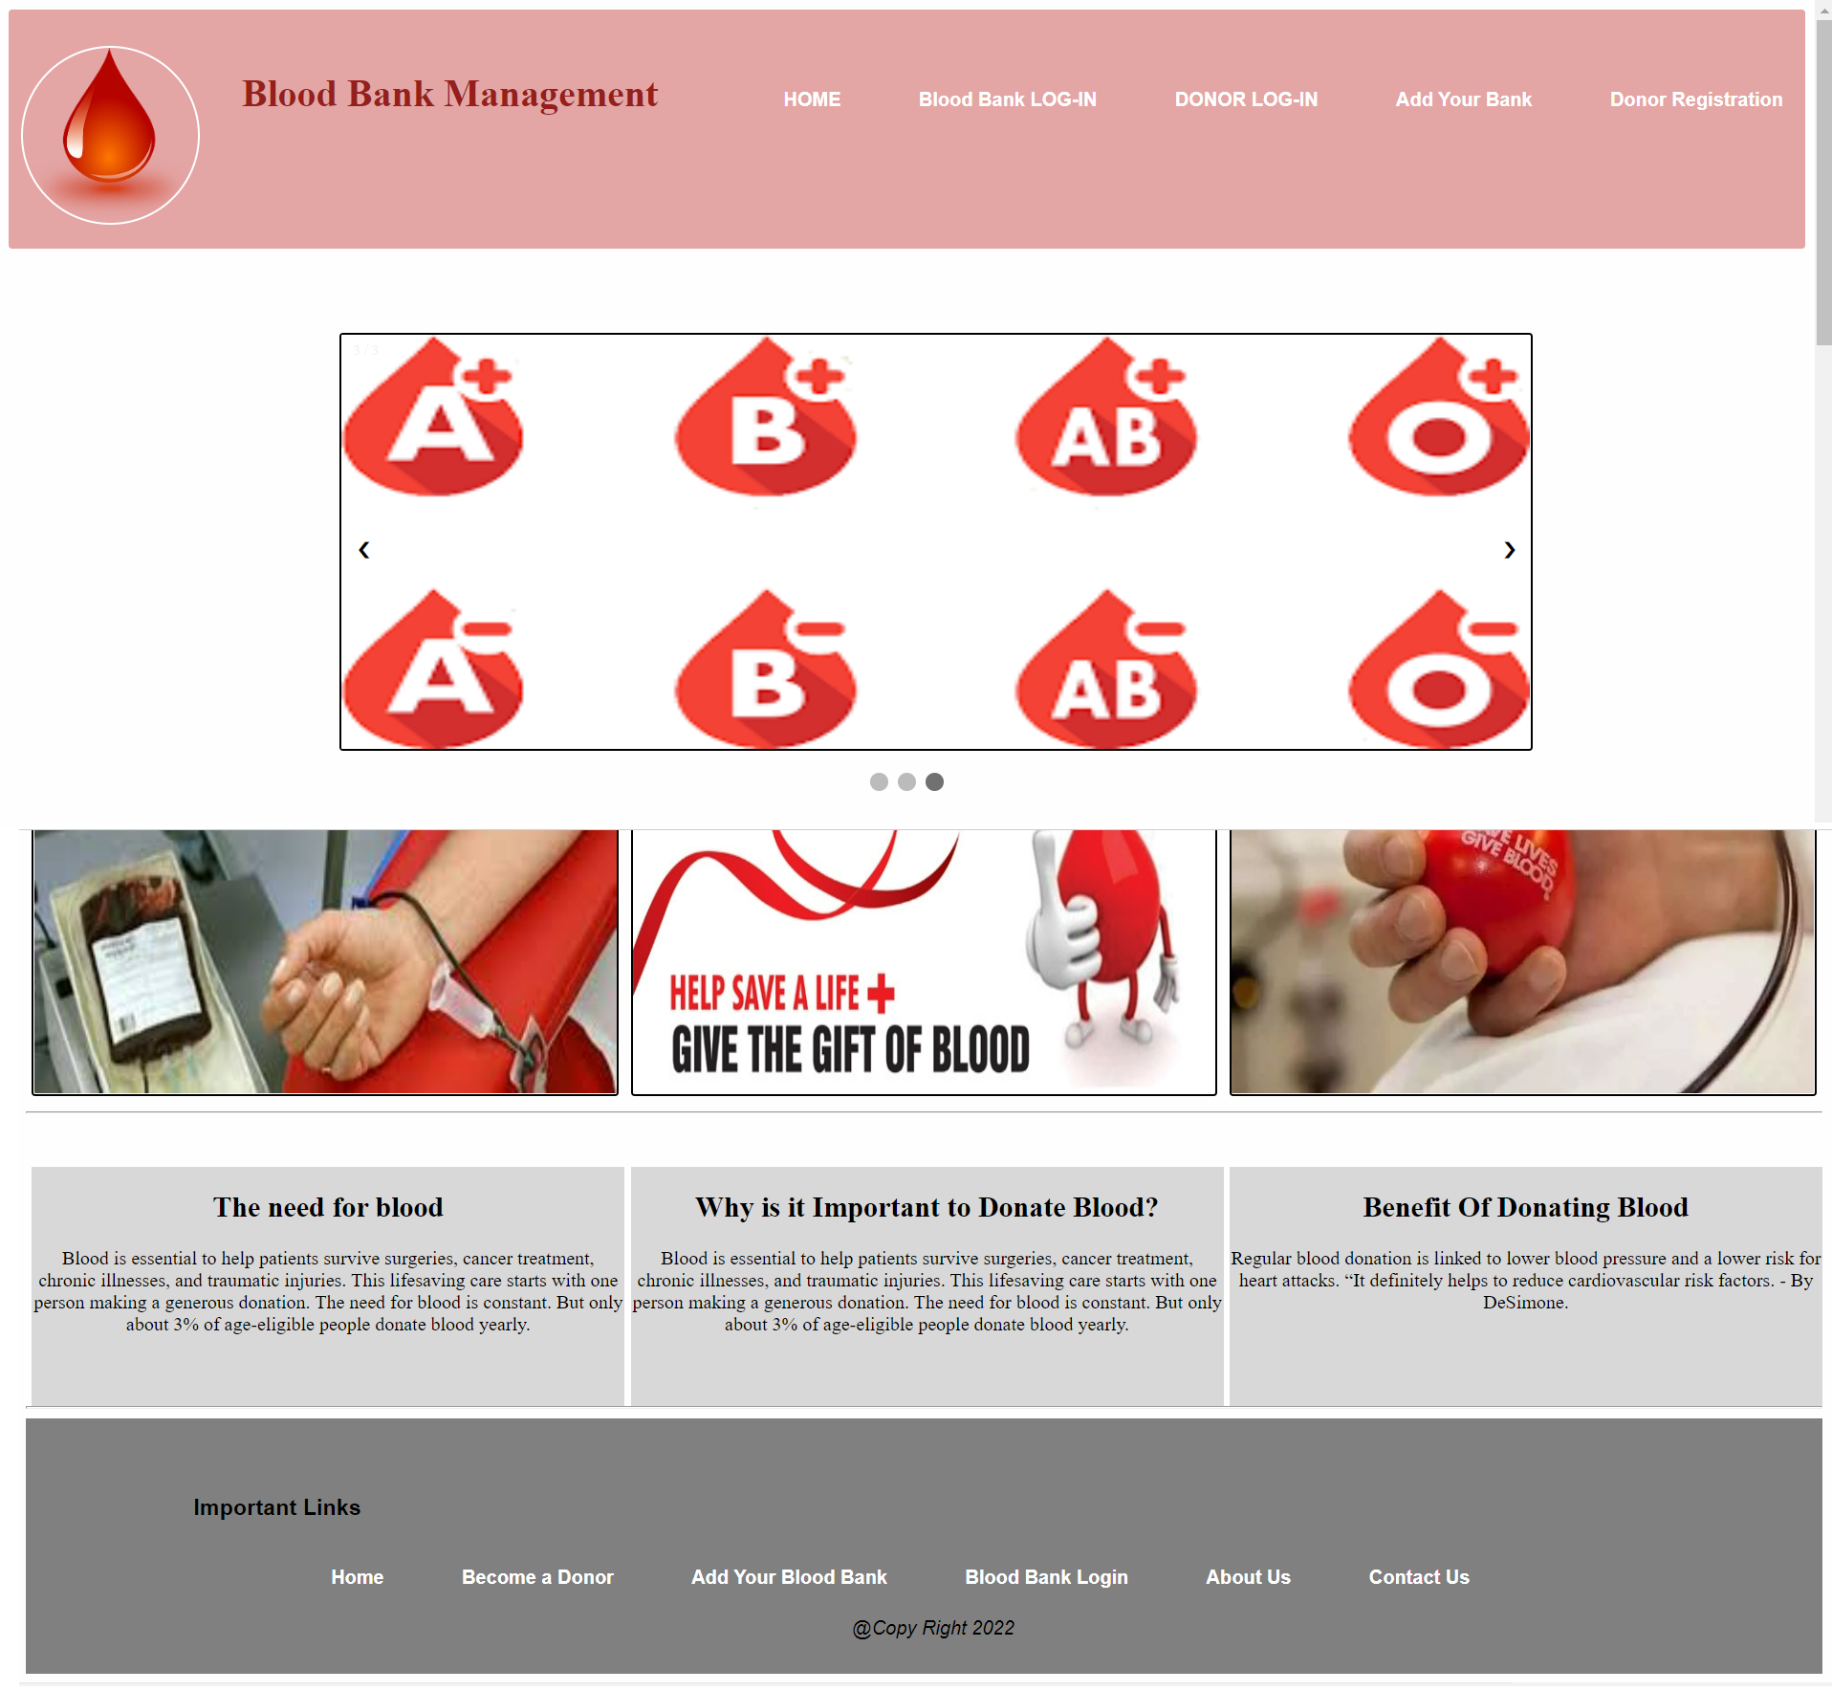
Splash Screen Frame/ Home Page

Slide 13
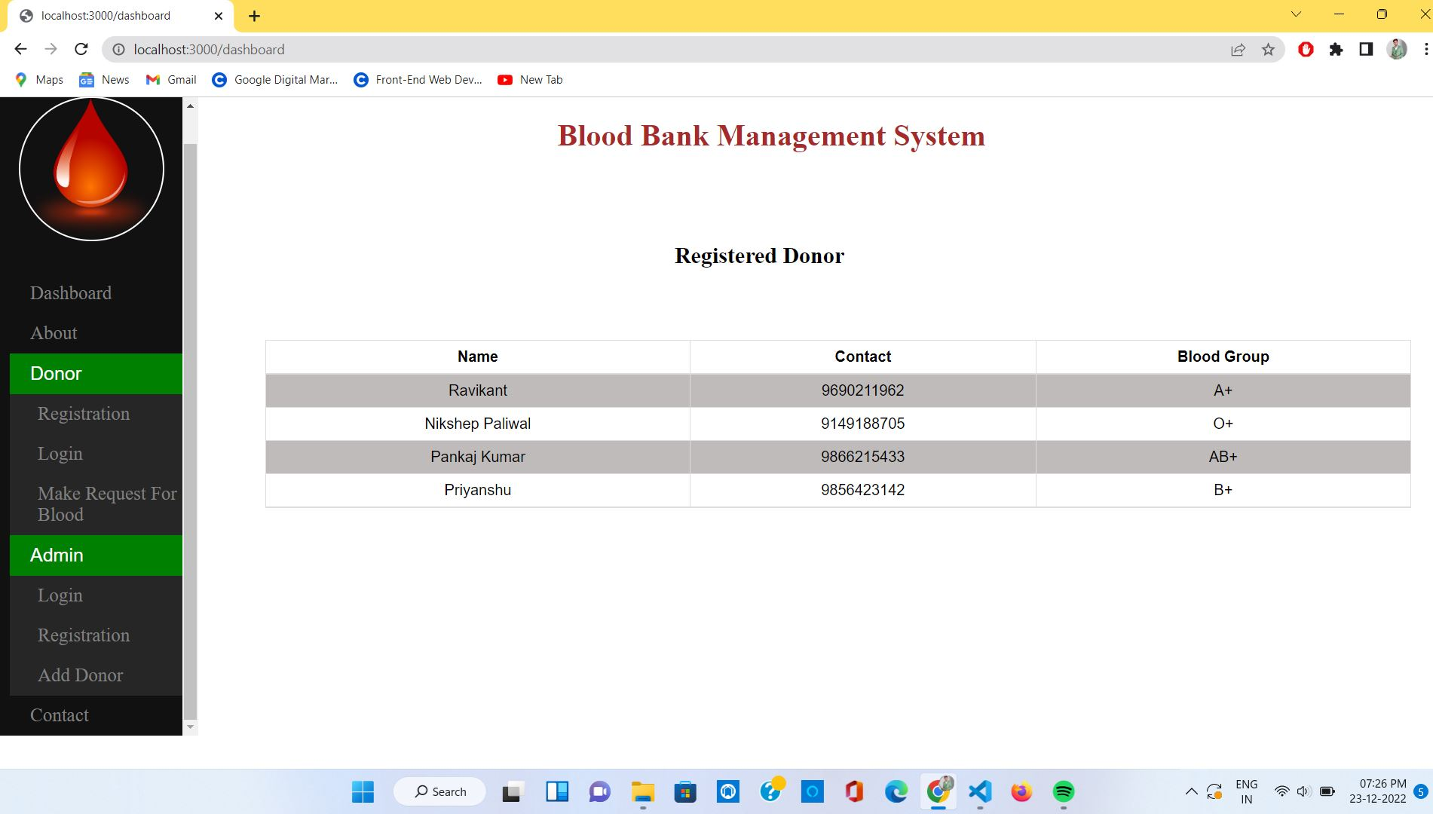
DashBoard

Slide 14
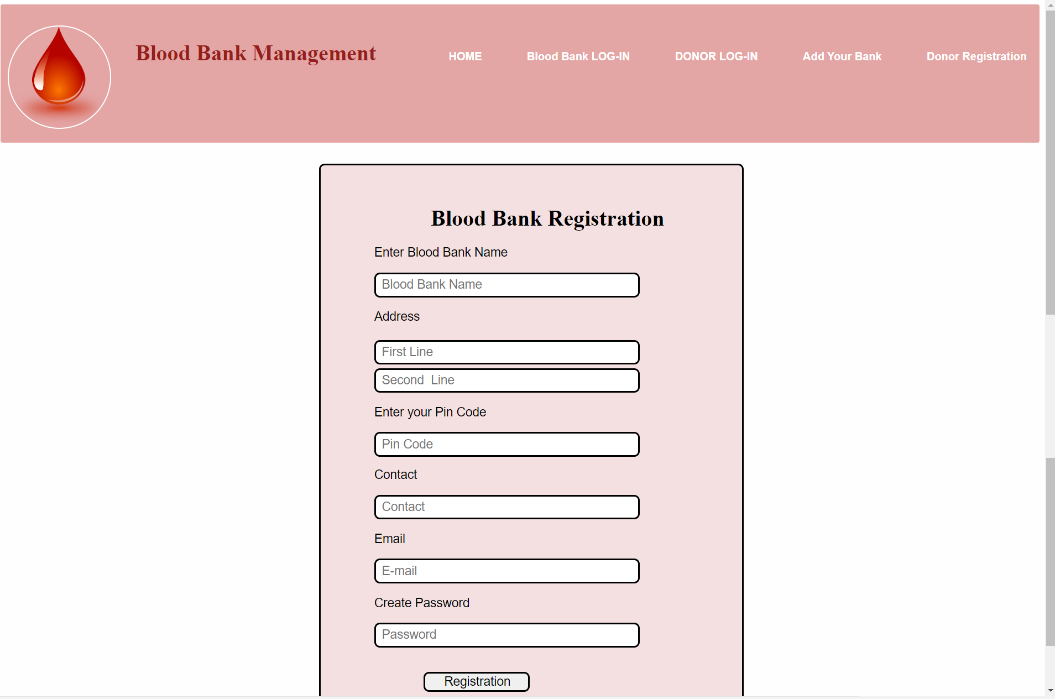
Blood Bank Registration Frame

Slide 15
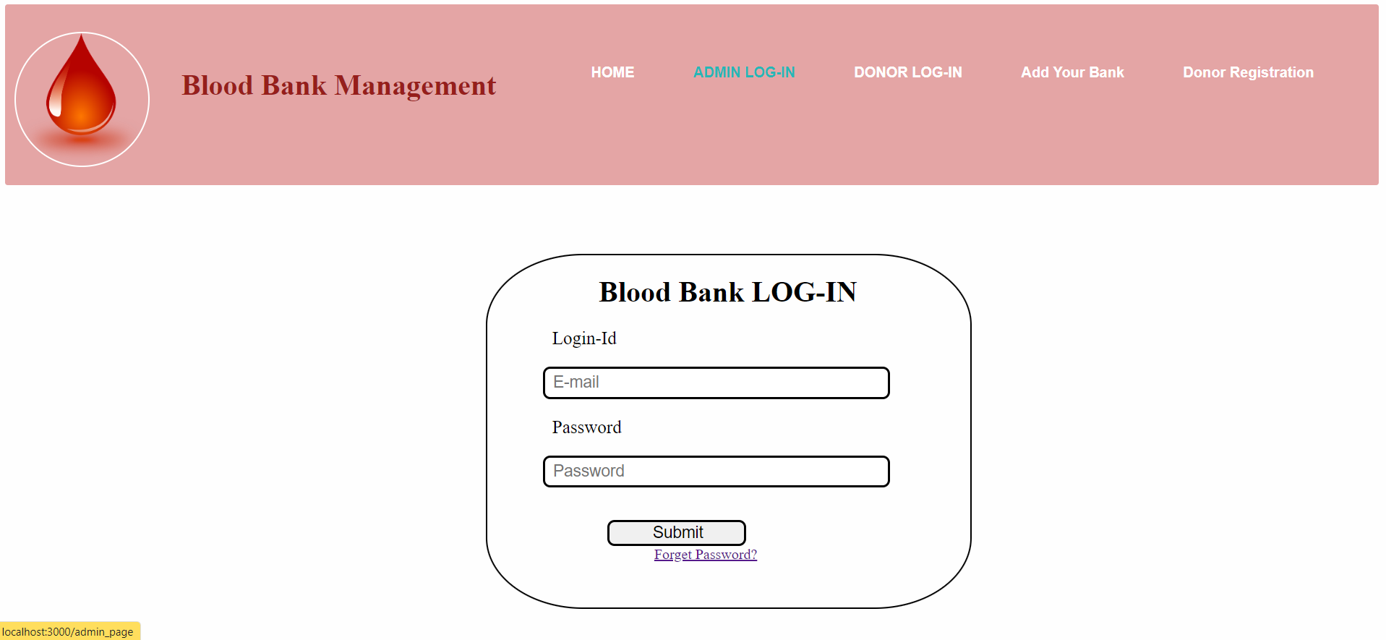
Blood Bank Login Frame

Slide 16
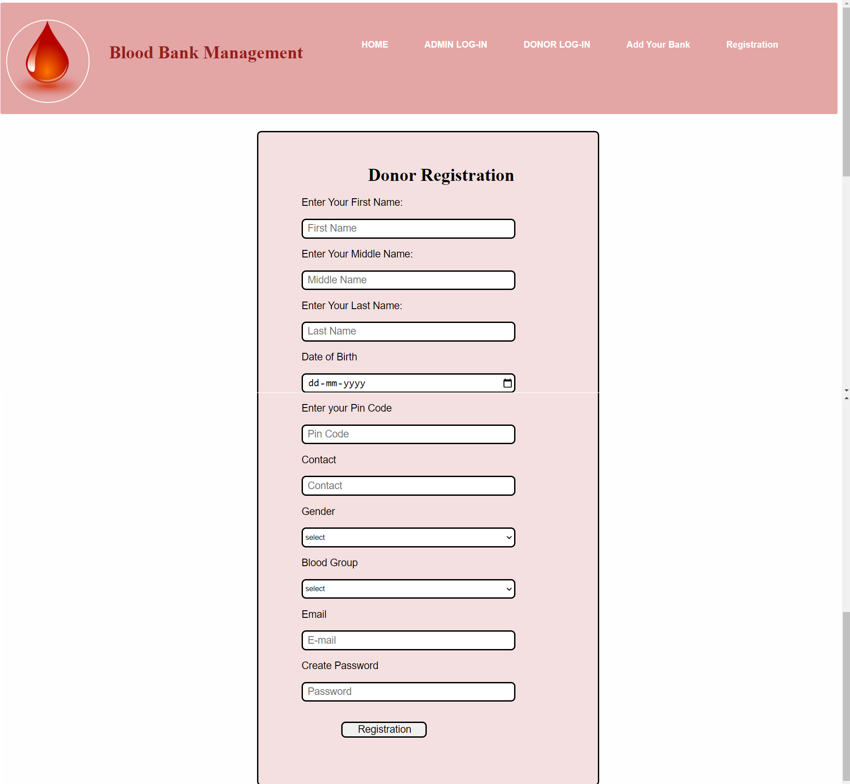
User Registration Frame

Slide 17
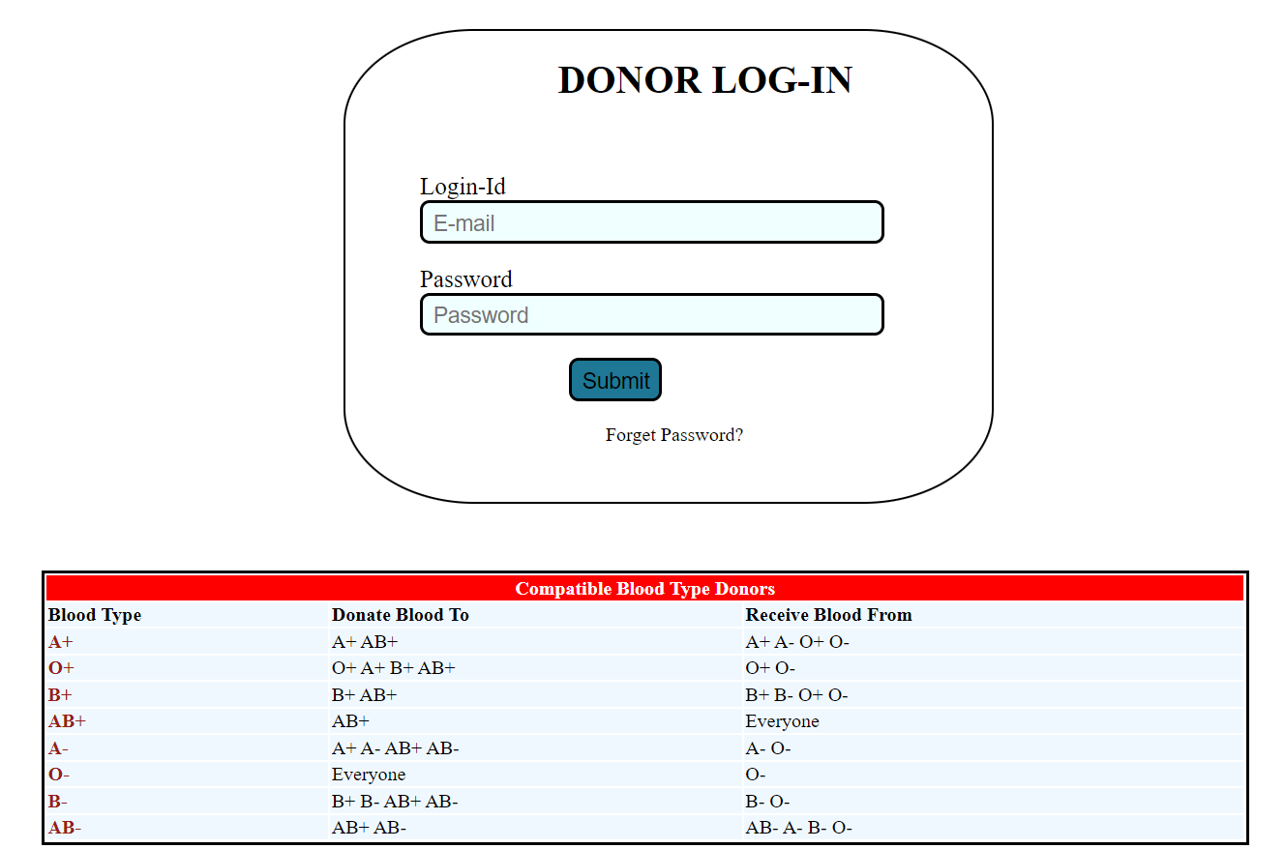
Donor Login

Slide 18
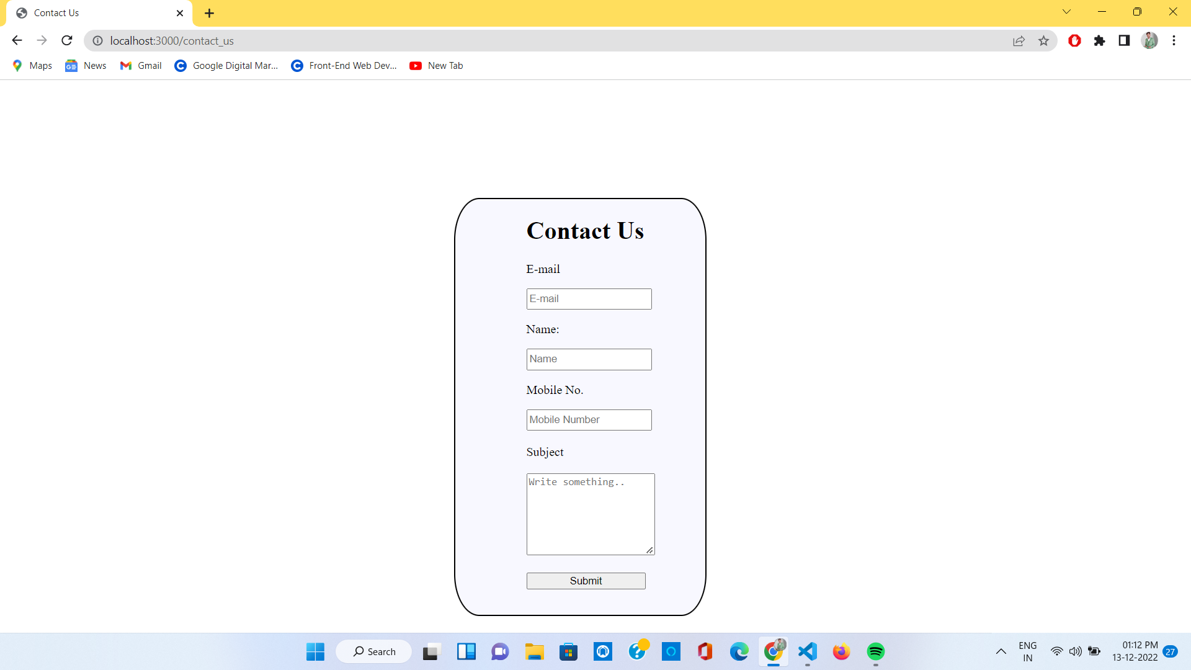
Contact Us Page

Slide 19
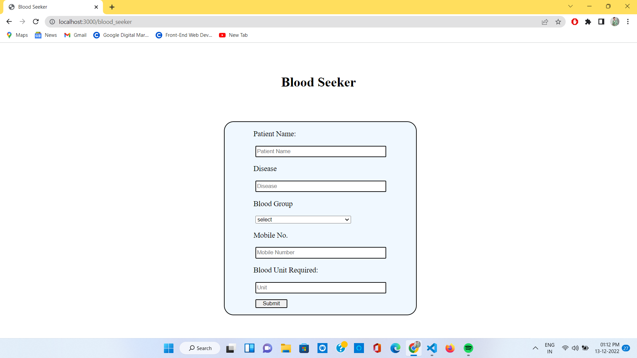
Blood Request Page

Slide 20
Conclusion
Based on the results, this study concluded that Online Blood Bank Management System is much better and Secure than the Manual Blood Bank System because it offers many advantages and benefits that lead to its effectiveness, efficiency and less time consuming .
Online Blood Bank management System is Easy to manage all Records and works in real time.

Slide 21
Reference
www.javatpoint.com
www.w3school.com
Geeksforgeeks
https://developer.mozila.org/en-US/docs/Learn/Server-side/Express_Nodejs

Slide 22
FUTURE SCOPE
We can enhance this System by including more facilities like Emergency SMS for Donor which are ready for Donating Blood.
Today, the market place is flooded with several Blood bank management options for blood bank to choose from. A variety of innovative products and services are being offered spoiling customers for choice. Blood Bank Management System is no more a privelage enjoyed by managers and employees. In the last couple of years, the growth of IT industry has been phenomenal as more have started Discovering the benefits of using this platform. Therefore we have made this System live and provide Software as Service(SAS) in future.

Slide 23


